Slide 1
Global Climate
Trend
Variability
Rate
Environment
All Taxa
Artiodactyla
Carnivora
Cetacea
Perissodactyla
Primates
Hominins
Adaptation
Adaptation
Adaptation
Adaptation
Adaptation
Adaptation

Slide 2
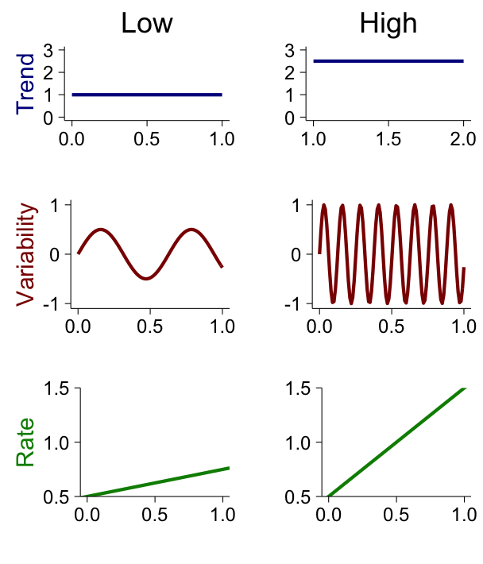
Global Climate
Trend
Variability
Rate
Global Climate
Environment
Artiodactyla
Carnivora
Cetacea
Perissodactyla
Primates
Hominins
N/A
++
N/A
+++
+
N/A
Brain Size Response

Slide 3
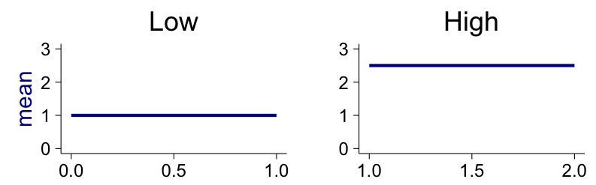
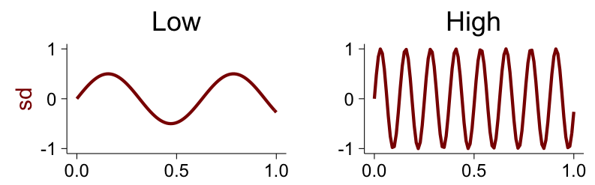
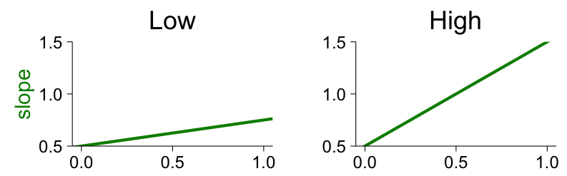
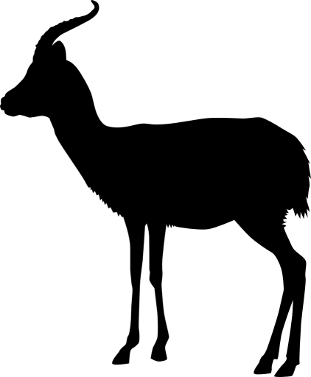

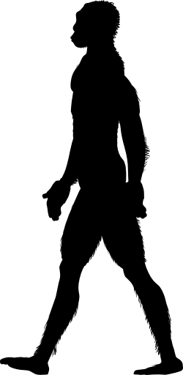

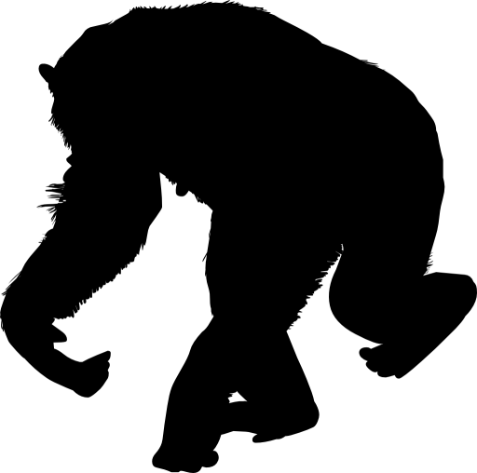

Global Climate
Trend
Variability
Rate
Global Climate
Artiodactyla
Carnivora
Cetacea
Perissodactyla
Primates
Hominins
Environment
Artiodactyla
Carnivora
Cetacea
Perissodactyla
Primates
Hominins
None
++
None
+++
+
None
Degree of Brain Size Response

